Slide 1
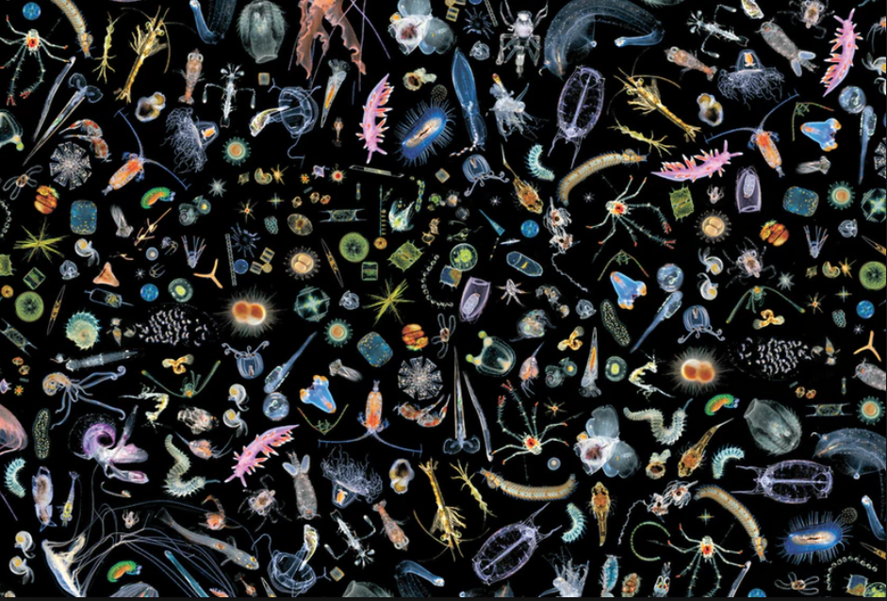
Size Spectrum Modeling
Gustav Delius, Richard Southwell

Slide 2


Slide 3
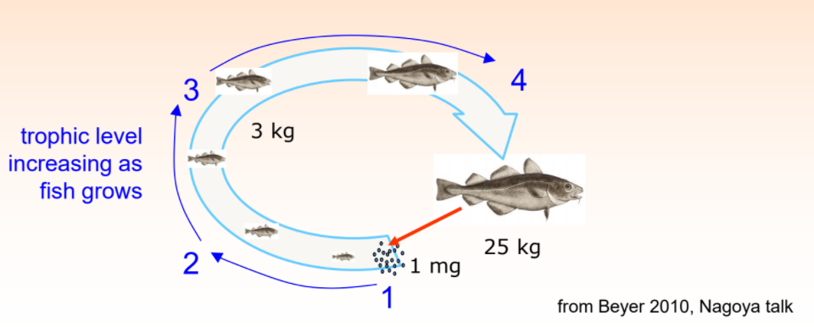

Slide 4
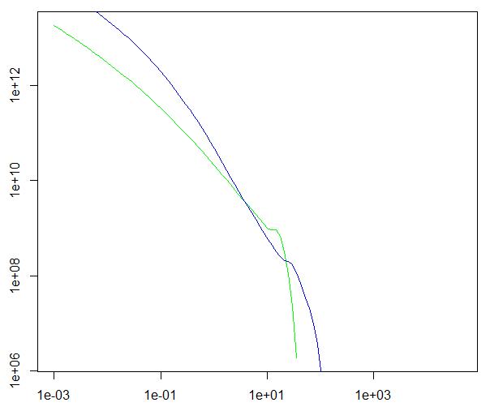


abundance
weight

Slide 5

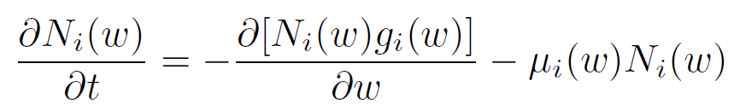

McKendrik-von Foerster equation

Slide 6
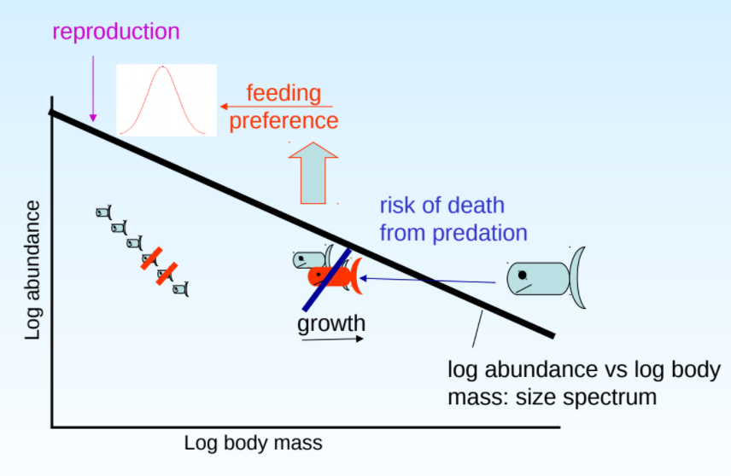

Slide 7




sum over prey
weight by preference
energy encountered
multiply by search rate of predator

Slide 8
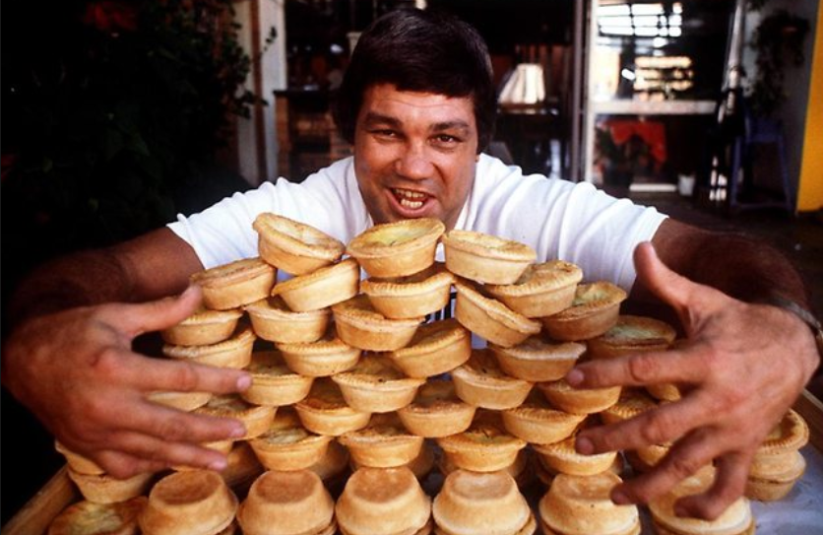
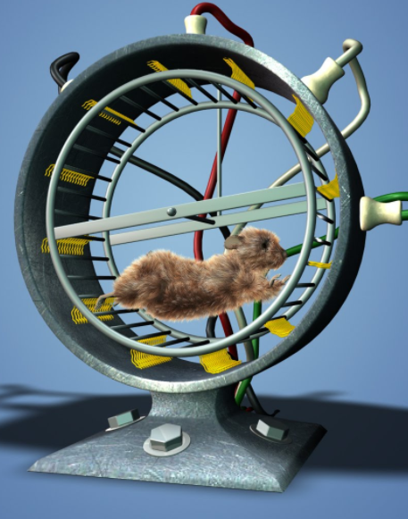


limited eating rate
energy costs for movement
and metabolism
energy for reproduction
growth

Slide 9
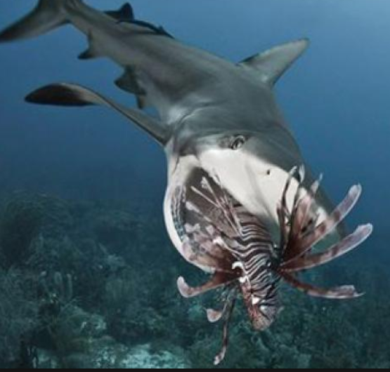


?

Slide 12
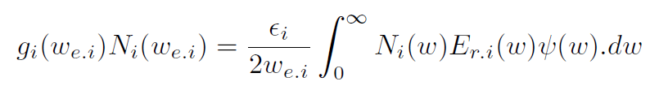

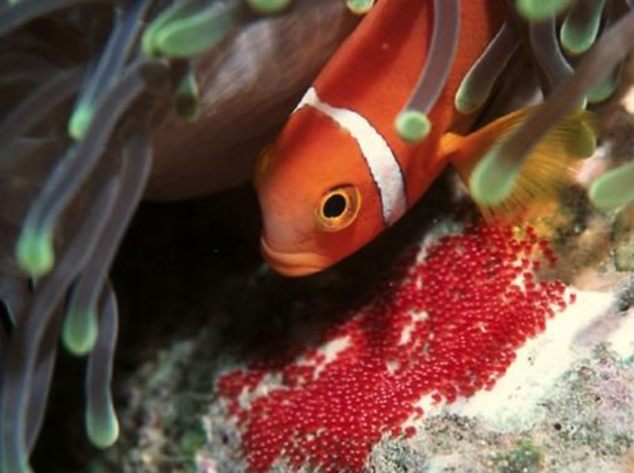

Slide 13
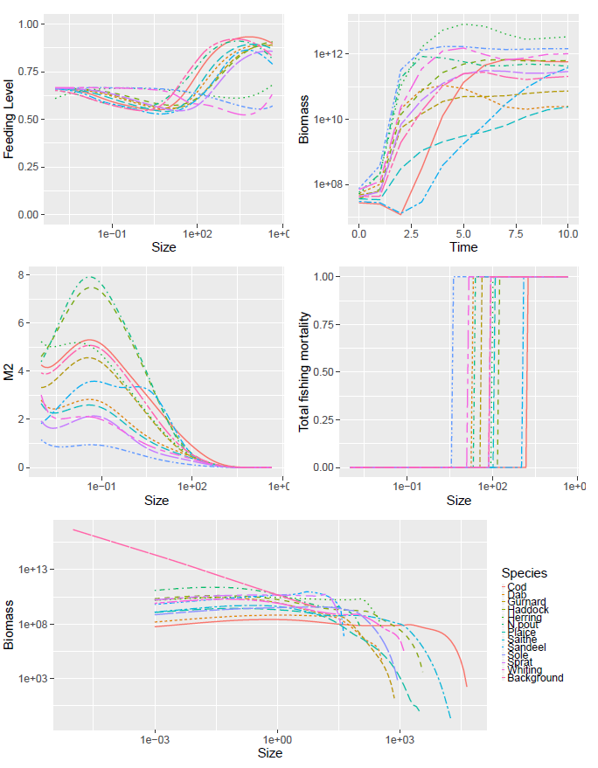

Slide 14


Slide 15
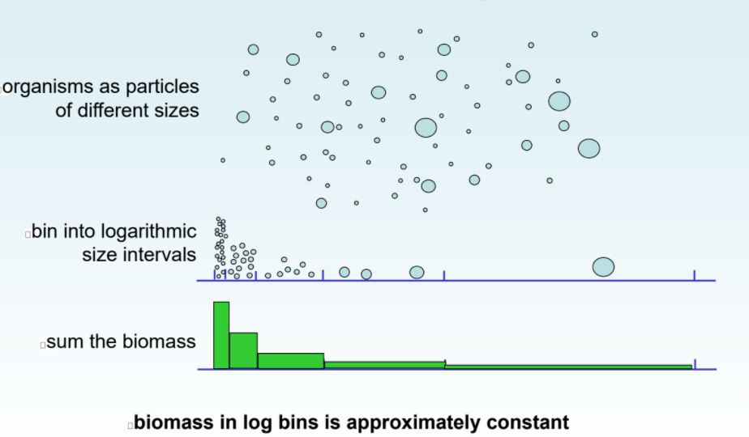
1
10
100
1000
Weight (g)
10000
100000

Slide 16
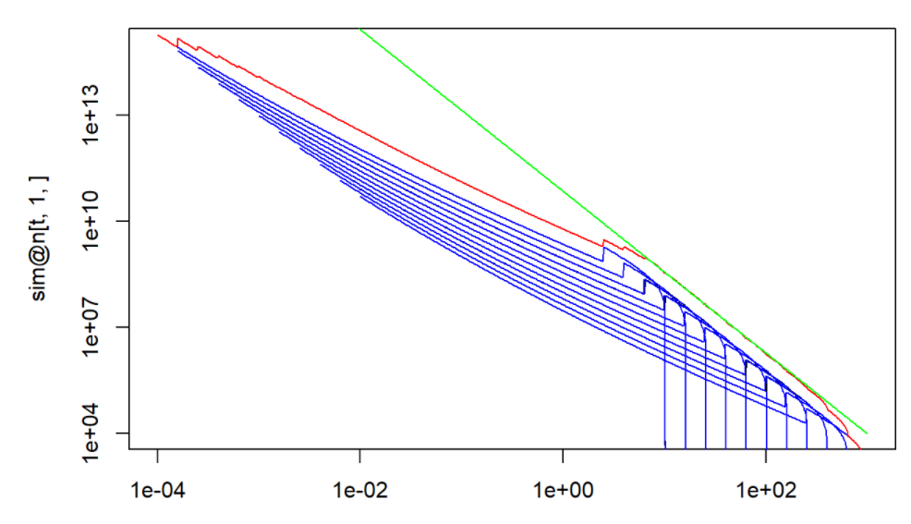
abundance
weight(g)

Slide 17


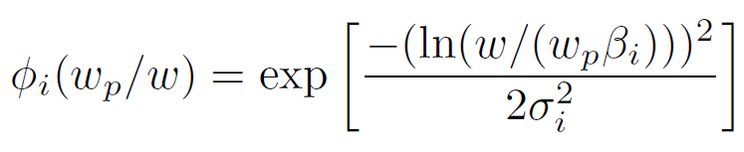

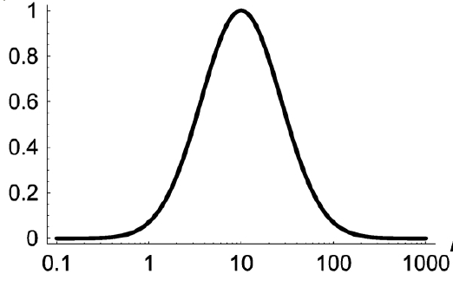








Slide 18



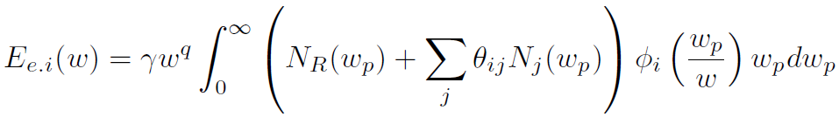


Slide 19
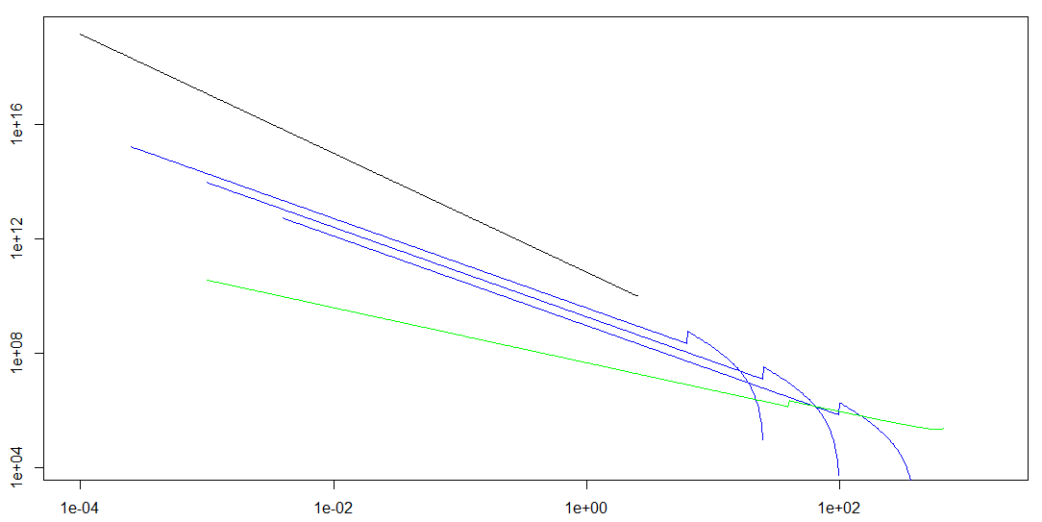

Slide 20
Size Spectrum Modelling
Gustav Delius, Richard Southwell

